Slide 1
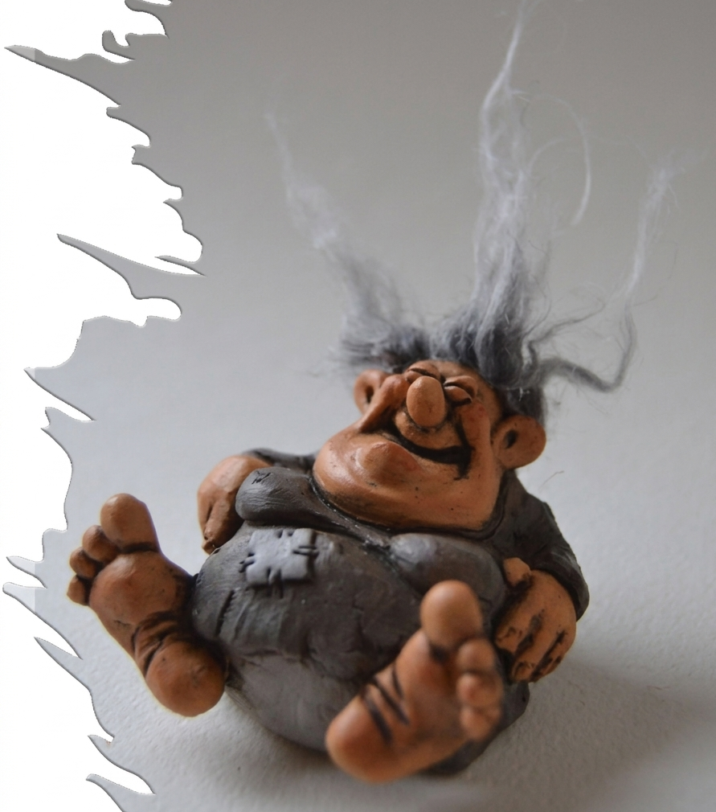
The R-parameter
A Workshop on
Merge,
Move,
and Celebrate

Slide 2
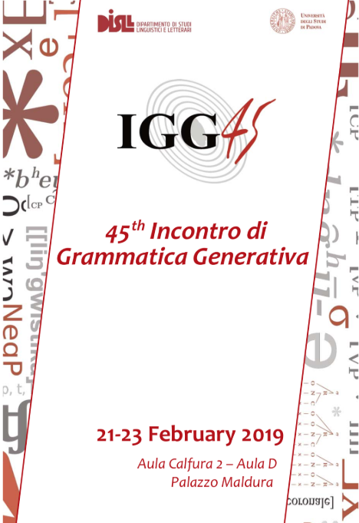
2019

Slide 3
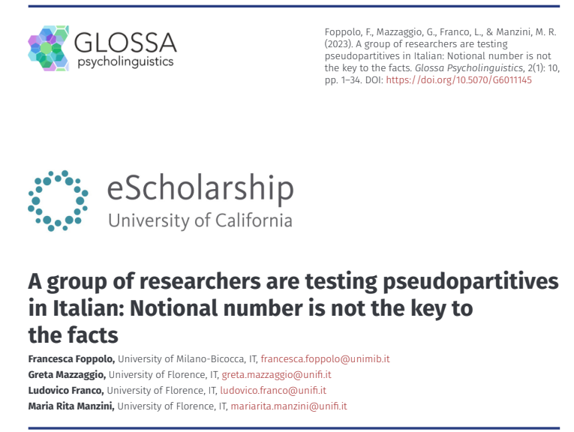
2023

Slide 4
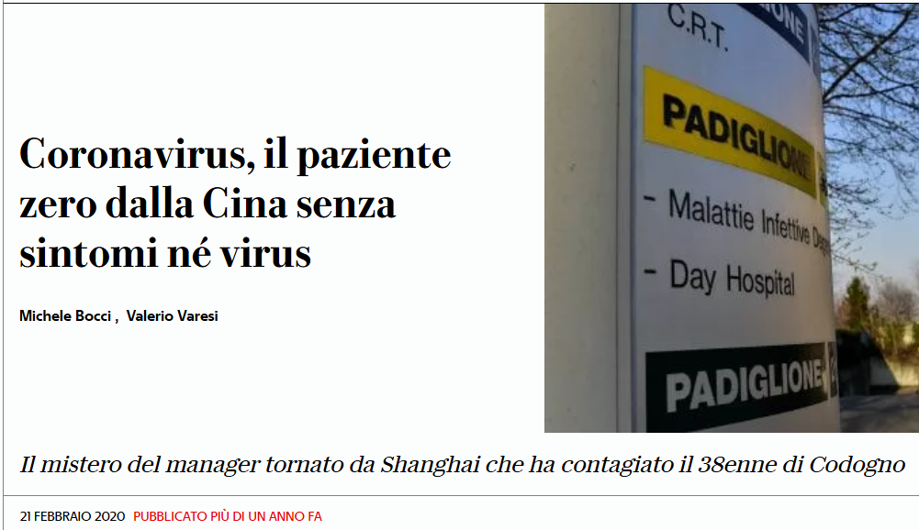
2020

Slide 5
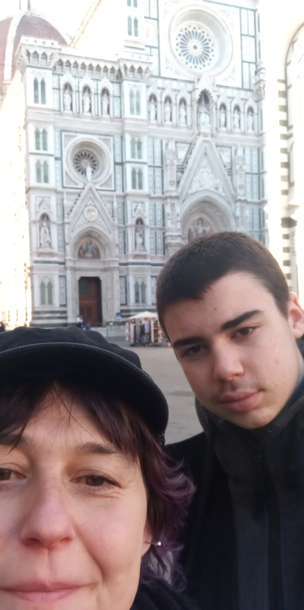
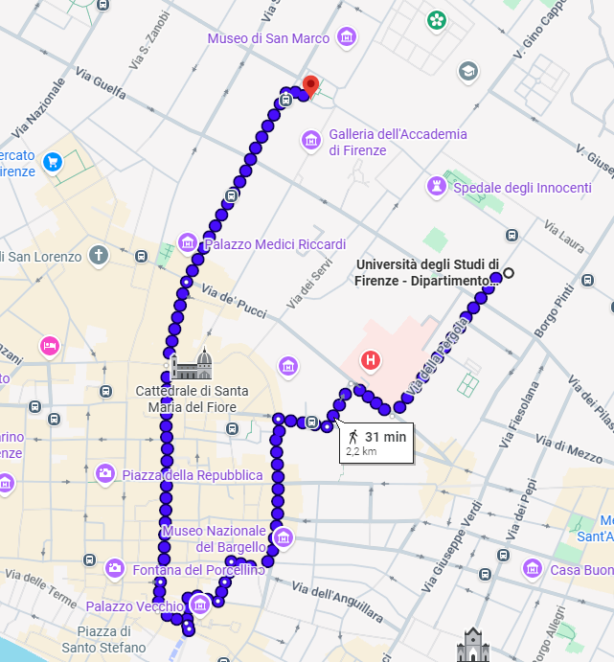
2022

Slide 6

*…she fortifies the ties of true friendship and protects against deceit and disappointment. She helps to break free from worn-out bonds and from leeches.
Strega Stramonia
Allegra e chiacchierona, esperta in antiche pozioni le usa per aiutare gli innamorati a rafforzare il legame e chi non lo è a trovare l’amore, rende forti i rapporti di amicizia vera e protegge dagli inganni e dalle delusioni. Aiuta a liberarsi dai legami logori e dalle cozze.

Slide 7
The R-parameter
A Workshop on
Merge,
Move,
and Celebrate

Slide 8
Raising the Bar:
A Unification Theory of R Impact

Slide 9
11.00 - 12.00 Unification and non-unification theories of control and raising
Rita Manzini (Università di Firenze)
12.00 - 12.45 Clitic climbing and modal ellipsis - Remarks on Manzini & Scheer 2025
Diego Pescarini (CNRS, Nizza)
12.45 - 14.30 Lunch @ Iuta Bistrot
14.30 - 15.15 She caused it: Clausal Embedding and Other Things Rita made Us Do
Paolo Lorusso (Università di Udine) & Linda Badan (Università di Padova)
15.15 - 16.00 Nomen omen, or something else? On impersonal ‘si’ in Italian restructuring sentences
Elisa Di Domenico (Università per Stranieri di Perugia)
16.00 - 16.45 RM, locality, and the box approach
Anna Roussou (University of Patras)
16.45 - 17.00 Coffee break
17.00 - 17.45 Reduced structures and ergativity
Caterina Donati (Université Paris Cité)
Controlling the Field: Why Rita is the Ultimate Antecedent
2026
No Ellipsis Required: A Full Disclosure on R Genius
R-Causative: Making Us All Better Linguists
Nomen Omen: Why 'Rita' translates to 'Syntax' in every language
Thinking Outside the Box: Defining the Domain of R-Brilliance
Maximal Projections, Not Reduced Structures: The Full Scale of R-Work

